Slide 1
VDUNY – The Plan
The next few months in a nutshell

Slide 2
VDUNY – The Plan
Meeting Space
Additional socialization
Website

Slide 3
Meeting Space
This location is too small
We’ve reduced attendance to compensate
Have not been able to get traction at RIT
Suggestions?

Slide 4
Additional Socialization
What’s the most useful interaction?
Do you want more: Training & Presentations or Social Meetups?
Online Presence (cutting back)
Facebook Group (1 member, abandoned 2010)
Twitter account (37 followers, abandoned 2011)
LinkedIn (147 members)

Slide 5
Web Site
Want a living site
Must have:
Upcoming meetings
“About Us” and “Contact Us”
What else?

Slide 6
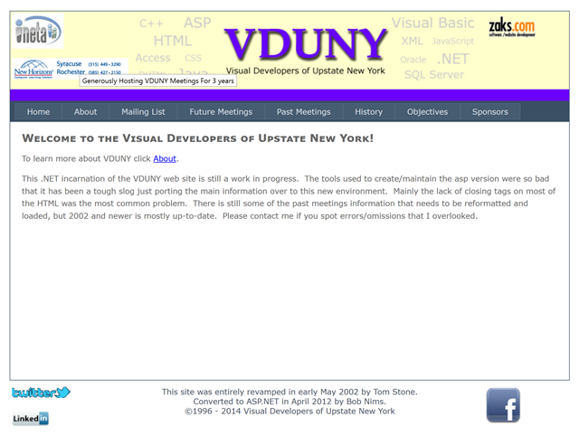
The CURRENT VDUNY SITE
Notes:
There are links here to twitter and facebook pages that haven’t been used since 2011, and then there’s the “meetings” pages – which nobody uses (because?) – maybe they’re just too hard to find/use.
The site is costing us $50/quarter (?!) to host, which is ridiculous considering it’s basically nothing, and we could host it on Azure free ;-)

Slide 7
The Plan
Spec and design an Asp.NET site
Use the process to guide some talks this year
Starting with last month’s about source control
And this month’s about templates
We need your help

Slide 8
Where we’re at
Requirements Gathering
Minimum Viable Product
Agile Iterations
Technology Stack

